Slide 1
Digital Portfolio
STUDENT NAME: Gopika.j
REGISTER NO AND NMID: 24132120500122012
BFBC7D62E85014D805741713507B41FC
DEPARTMENT: BCA
COLLEGE: COLLEGE/ UNIVERSITY: Siddhar Sivagnaani arts and science collage,bommayapalayam

Slide 2
PROJECT TITLE
Student portfolio

Slide 3


AGENDA
Problem Statement
Project Overview
End Users
Tools and Technologies
Portfolio design and Layout
Features and Functionality
Results and Screenshots
Conclusion
Github Link
3/21/2024 Annual Review

Slide 4

PROBLEM STATEMENT
HTML + CSS + JavaScript:👉 Create a responsive portfolio website with navigation, project showcase, and contact form using HTML, CSS, and JavaScript.HTML + CSS + Java:👉 Develop a student management system with HTML/CSS frontend and Java backend for adding, updating, and viewing student records.

Slide 5

PROJECT OVERVIEW
It seems like you're looking to discuss or work on a project. Could you provide more details about the project, such as:- What is the project's goal or objective?- What type of project is it (e.g., web development, research, design)?- What stage is the project currently at?This will help me better understand your needs and provide more effective support.

Slide 6

WHO ARE THE END USERS?
It seems like you're working on a project related to Java and CSS.Java is often used for:- Back-end development (server-side logic, database integration)- Android app developmentCSS is used for:- Front-end development (styling, layout, visual design)Are you working on a:- Web application?- Mobile app?- Desktop application?More context will help me provide more specific assistance.

Slide 7

TOOLS AND TECHNIQUES
🔹 Tools & Techniques to access HTML in JavaParse HTML → Jsoup, HTMLUnitGenerate HTML → JSP, Servlets, Thymeleaf/FreemarkerDisplay HTML → JavaFX WebView, Swing JEditorPaneTest/Automate → Selenium (Java)

Slide 8
POTFOLIO DESIGN AND LAYOUT
Principles → Simple, consistent, responsive, clear, attractive.Sections → Header, About, Work/Projects, Skills/Resume, Contact, Footer.Layouts → Single-page, grid,
8

Slide 9
FEATURES AND FUNCTIONALITY
User-Friendly Design → The website is simple and clean, so anyone can easily navigate.Header & Navigation → Provides quick links to each section like About, Skills, Projects, and Contact.About Section → Gives a short introduction of the student.Skills Section → Highlights technical abilities such as HTML, CSS, JavaScript, etc.Projects Section → Displays the list of projects completed by the student.Contact Form → Allows visitors to send their details (name, email, message).JavaScript Functionality → Validates the contact form and gives a success message.Footer → Shows copyright note at the bottom

Slide 10
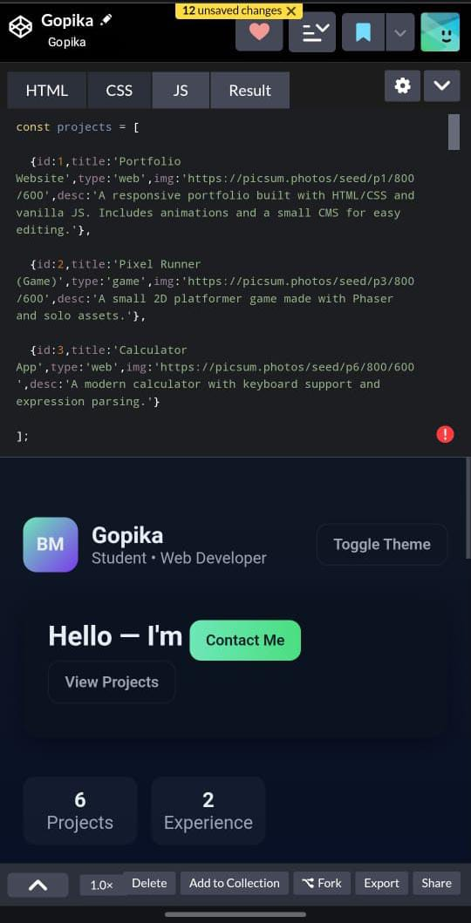

RESULTS AND SCREENSHOTS
3/21/2024 Annual Review
10

Slide 11
CONCLUSION
The Student Portfolio Website provides an effective online platform for students to present their personal details, skills, and projects in a professional way. Unlike traditional paper resumes, this website is interactive, easy to access, and visually appealing. It is developed using the fundamentals of web development — HTML for structure, CSS for design, and JavaScript for interactivity. The project not only helps students showcase their profile to recruiters and faculty but also improves their practical knowledge in creating and hosting websites. Overall, this project demonstrates the importance of web technologies in building a personal brand and enhancing career opportunities.
11

